Slide 1


Introduction to RNA-Seq – Differential Expression
Wandrille Duchemin
Notes:
1

Slide 2
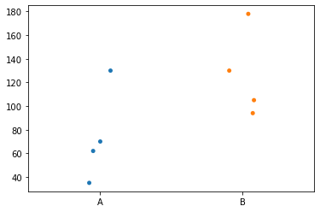
DE – the goal
?
Expression of GeneX

Slide 3

DE - challenges for RNA-Seq
Sequencing depth varies across libraries
High dynamic range
Limited number of samples
Large number of genes

Slide 4
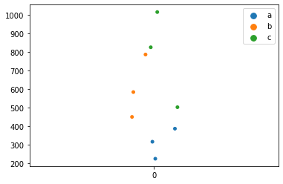
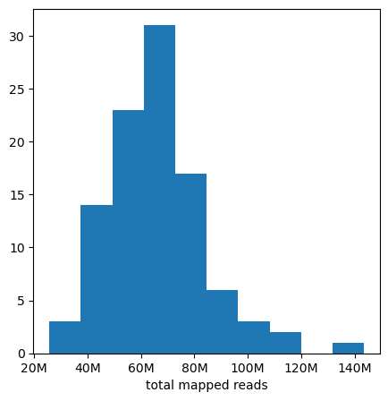
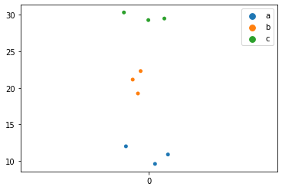
DE - challenges for RNA-Seq
Sequencing depth varies across libraries
Normalization

Slide 5
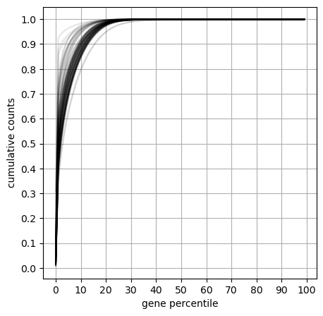
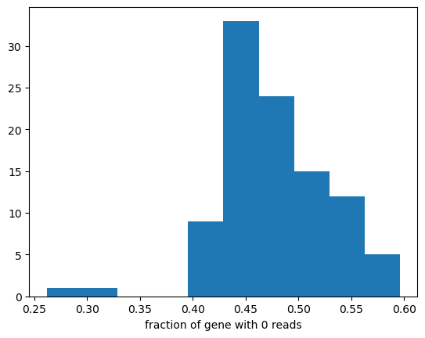
DE - challenges for RNA-Seq
High dynamic range

Slide 6
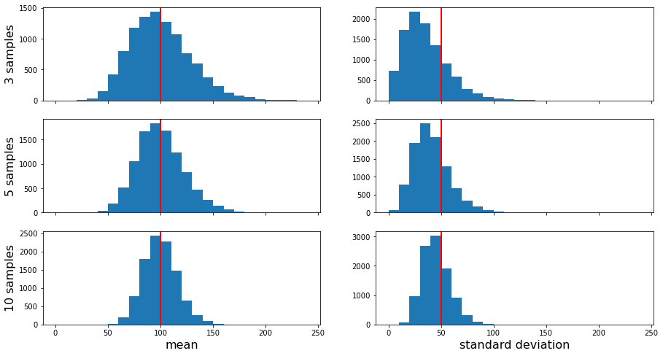
DE - challenges for RNA-Seq
Limited number of samples

Slide 7
DE - challenges for RNA-Seq
Large number of genes to test

Slide 8
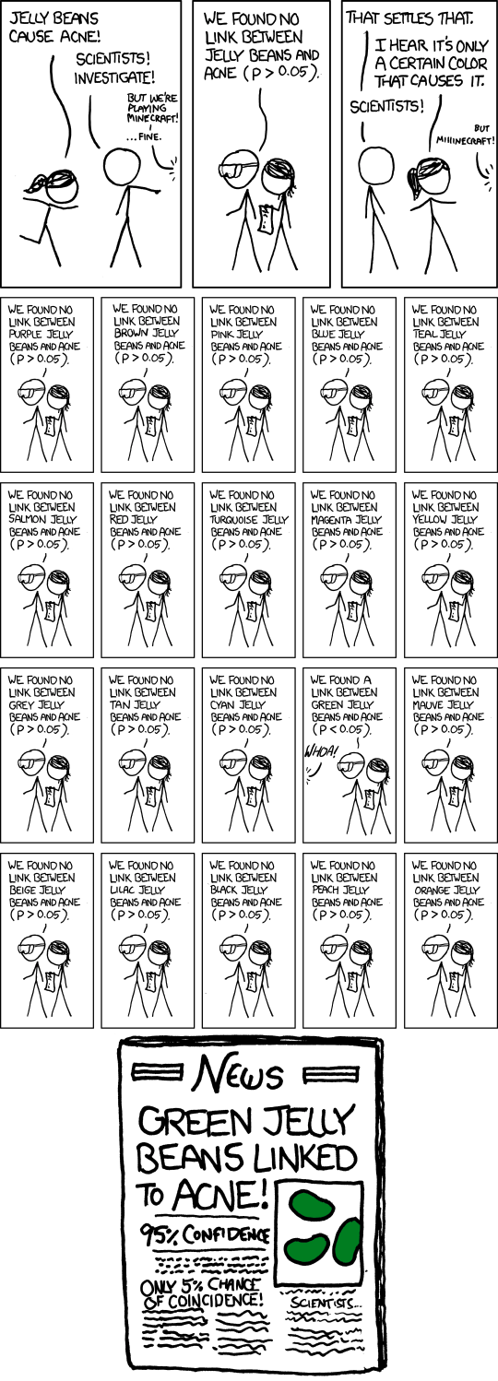
DE - challenges for RNA-Seq
Many genes to test
xkcd.com/882

Slide 9
DE - challenges for RNA-Seq
Many genes to test
Apply p-value correction for multiple testing
xkcd.com/882

Slide 10
DE – Input for Gene Differential Expression
Counts from mapping
Handling of overlap? Stranding?
Multi-mapping reads?
Affected by library size
TPM from pseudo-aligners
Tximport aggregates counts at the gene-level

Slide 11
DE – Input for Gene Differential Expression
Counts from mapping
Handling of overlap? Stranding?
Multi-mapping reads?
Affected by library size
TPM from pseudo-aligners
Tximport aggregates counts at the gene-level
EdgeR and DESeq2 expect raw counts

Slide 12
DE – digression: “naive” normalization
CPM (Count Per Million) : count / library size * 10⁶
RPKM (Reads Per Kilobase per Million):
CPM / gene length (kb)
TPM (Transcript Per Million):
RPK = Count / gene length (kb)
RPK / sum(RPK) * 10⁶

Slide 13
DE – “naive” normalization
CPM (Count Per Million) : count / library size * 10⁶
RPKM (Reads Per Kilobase per Million):
CPM / gene length (kb)
TPM (Transcript Per Million):
RPK = Count / gene length (kb)
RPK / sum(RPK) * 10⁶
Sum RPKM different between samples
Sum TPM constant between samples

Slide 14
DE – “naive” normalization
CPM (Count Per Million) : count / library size * 10⁶
RPKM (Reads Per Kilobase per Million):
CPM / gene length (kb)
TPM (Transcript Per Million):
RPK = Count / gene length (kb)
RPK / sum(RPK) * 10⁶
How do you compute “gene length” ?

Slide 15
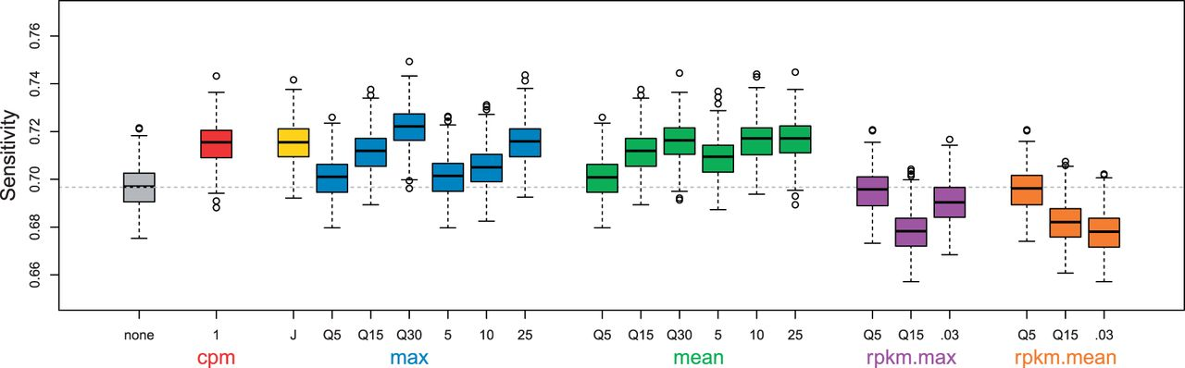
DE – Filtering low count genes
Very low counts genes :
Very little information. No chance of DE.
Filter : less p-value correction
Andrea Rau et al., 2009 https://doi.org/10.1093/bioinformatics/btt350
EdgeR: CPM > 10/(min lib size) in at least N samples
DESeq2 : mean normalized count optimizing # of DEG

Slide 16
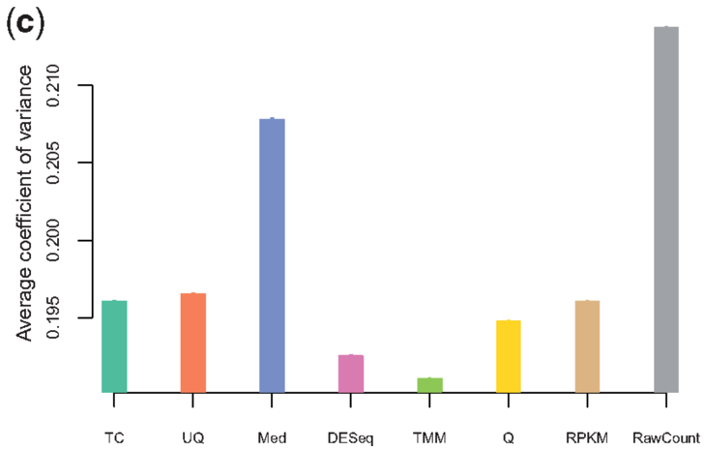
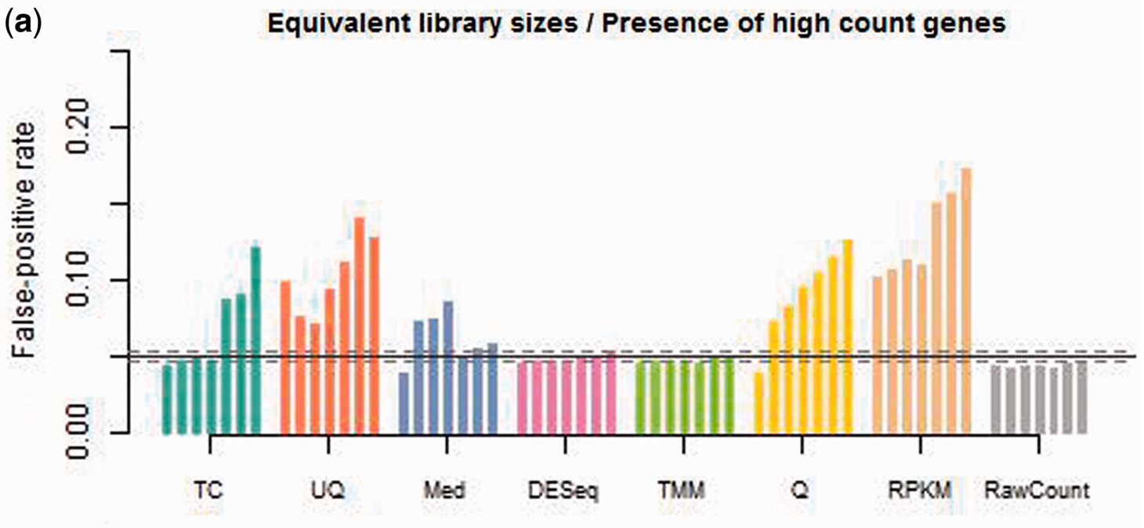
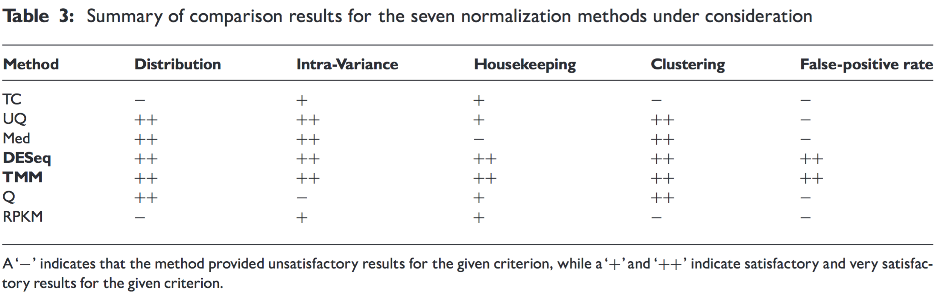
DE – Normalization
Dillies et al 2013 https://doi.org/10.1093/bib/bbs046

Slide 17
DE – Normalization
EdgeR : “Trimmed Mean of M-Values” (TMM)
DESeq2 : “Relative Log Expression” (RLE)
Both presume that most genes are not DE!

Slide 18
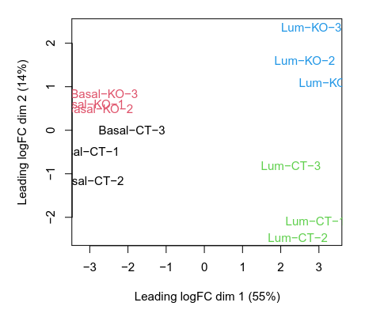
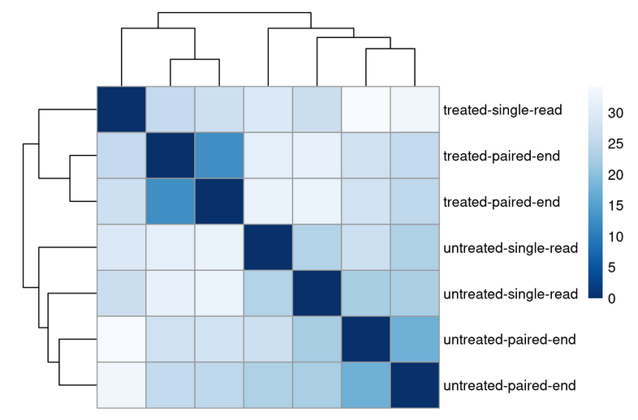
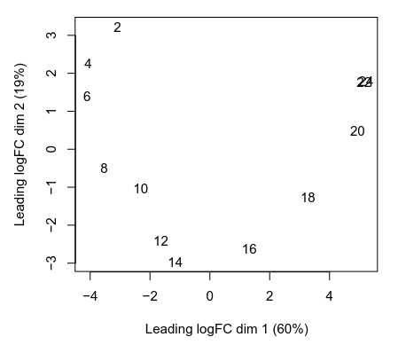
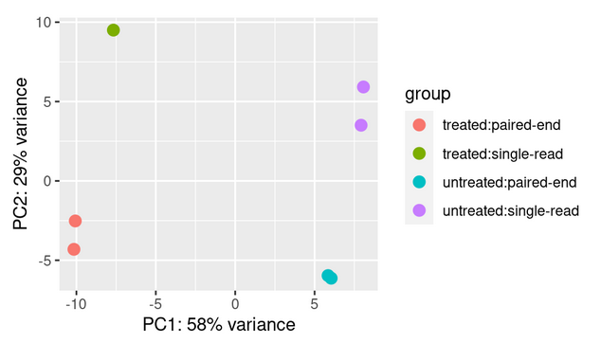
QC – MDS or PCA of the samples

Slide 19
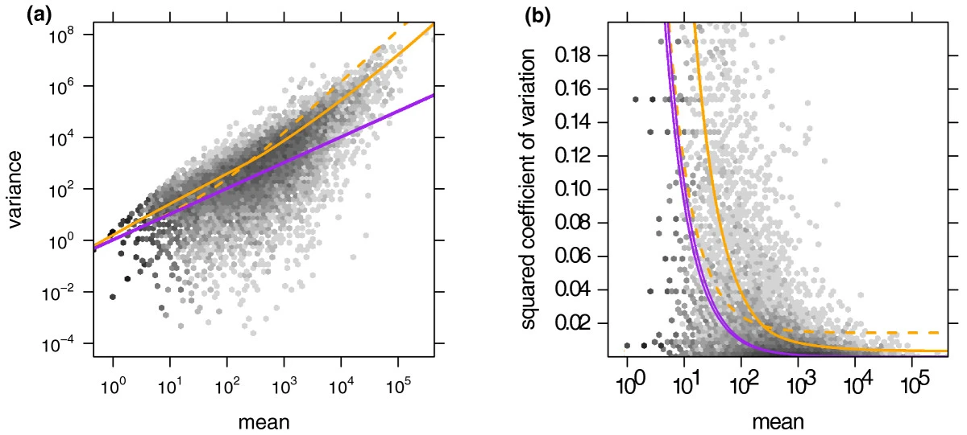
DE – negative binomial model
Generalized Poisson with over-dispersion
count of a gene in a sample ~ NB( μ , θ )
Variance = μ + θμ²
θ: dispersion parameter
Anders, S., Huber, W. 2010 https://doi.org/10.1186/gb-2010-11-10-r106

Slide 20
Shrinkage of dispersion estimates
Problem: we often have few replicates
Solution: take advantage of the large number of genes
shrink gene-wise estimates towards the center value observed of dispersion across genes with similar expression

Slide 21
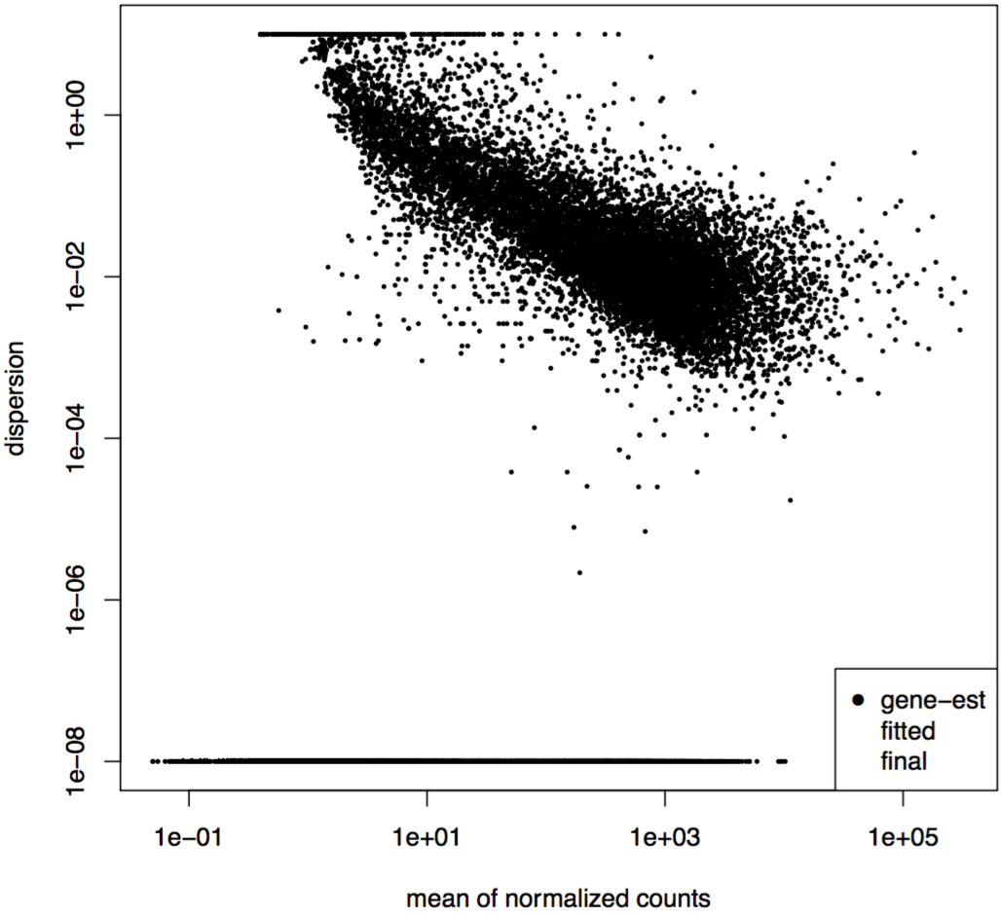
Shrinkage dispersion estimation
Charlotte Soneson

Slide 22
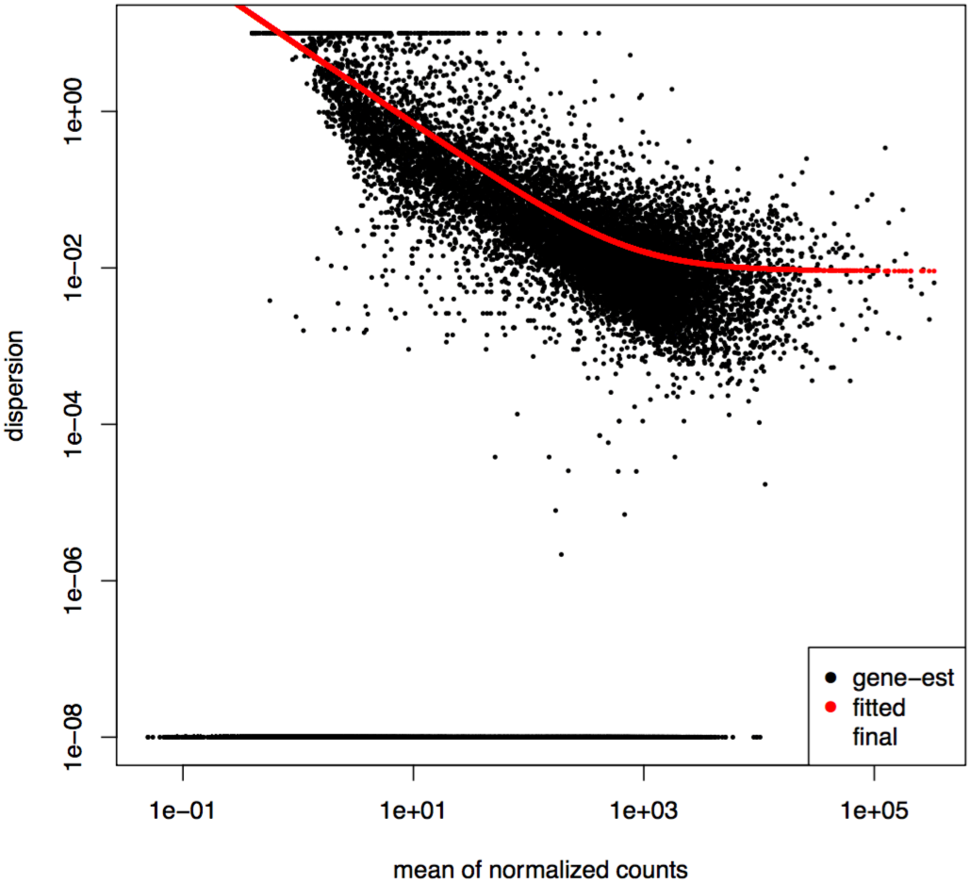
Shrinkage dispersion estimation
Charlotte Soneson

Slide 23
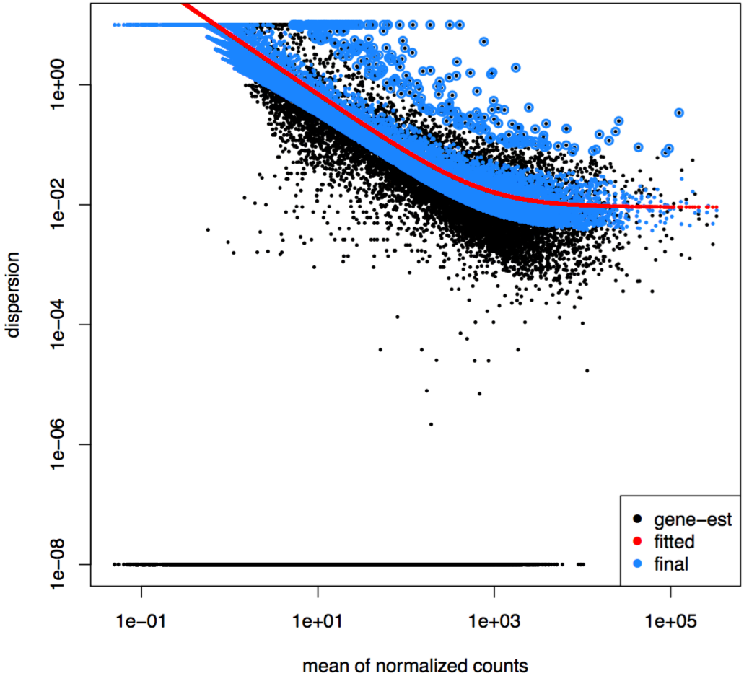
Shrinkage dispersion estimation
Charlotte Soneson

Slide 24
Tests for differential expression – DESeq2
For each gene:
Z-score = shrunken LFC / estimate standard error
Z-score → standard normal distribution → p-value (Wald test)
Benjamini-Hochberg procedure to adjust p-values
Notes:
Note: The multiple test correction in DESeq2 considers only genes that could potentially be detected as differentially expressed. Only these genes will have an adjusted P-value. The mean read count across all samples is used to decide if a gene should be included or not.
<number>

Slide 25
Tests for differential expression – edgeR
“simple” 1 factor : exactTest() ,
using the computed conditional distribution for the sum of counts in a group
Otherwise a GLM framework in used :
QL F-test : preferred → normally stricter error rate control
LRT : when “the dispersions are very large and the counts are very small, whereby some of the approximations in the QL framework seem to fail”
Notes:
Note: The multiple test correction in DESeq2 considers only genes that could potentially be detected as differentially expressed. Only these genes will have an adjusted P-value. The mean read count across all samples is used to decide if a gene should be included or not.
<number>

Slide 26
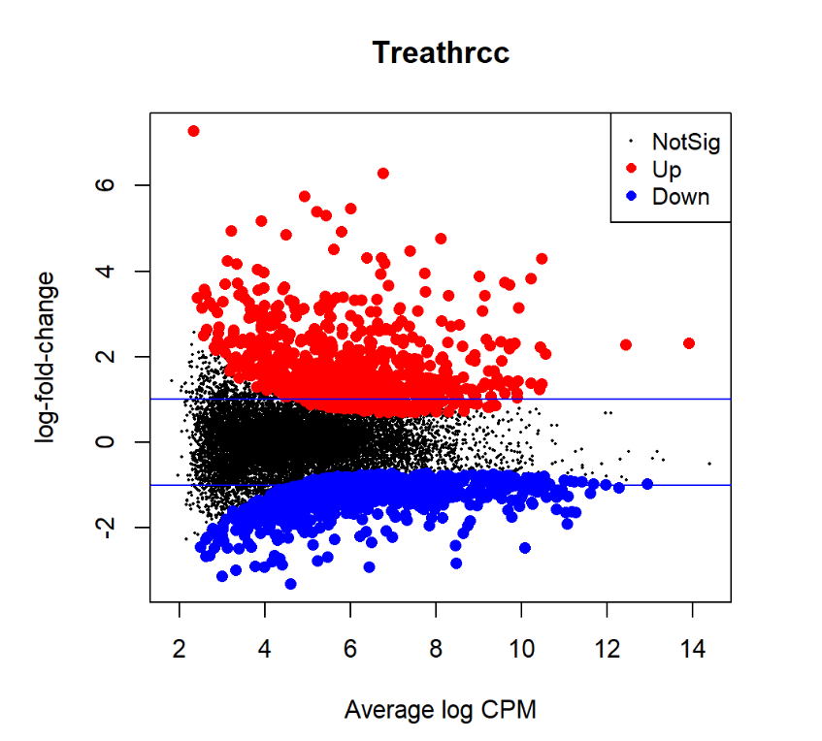
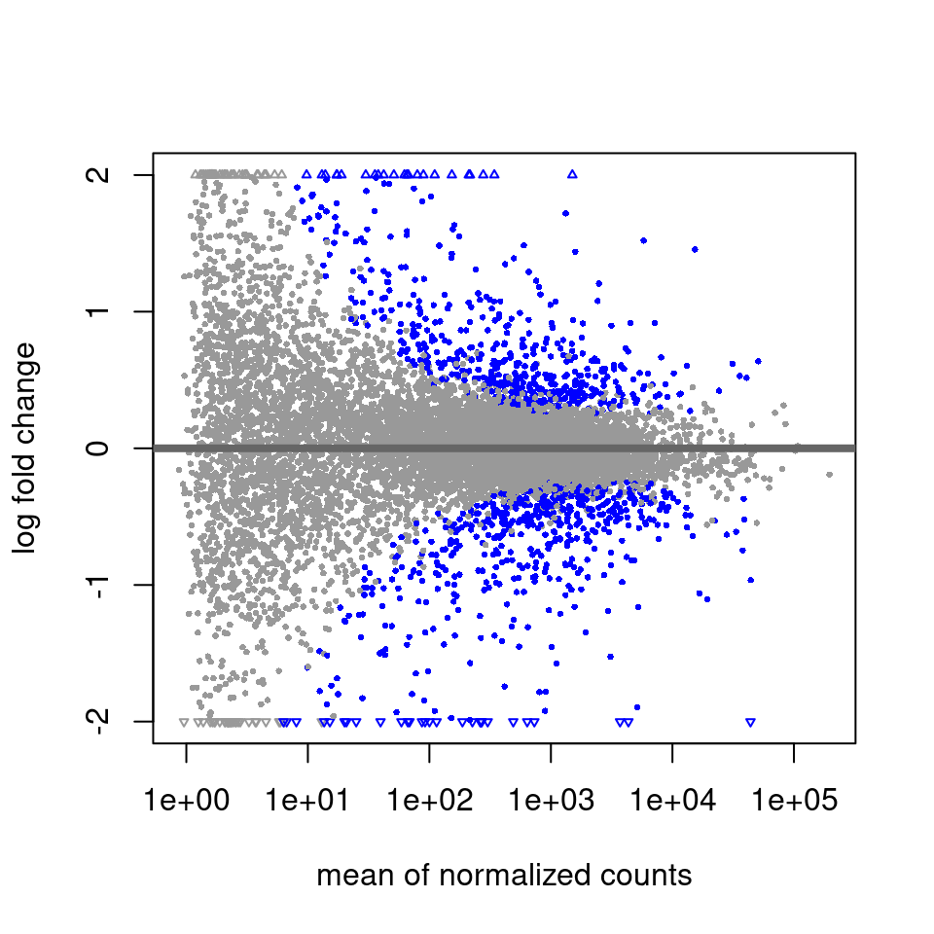
MA plot

Slide 27
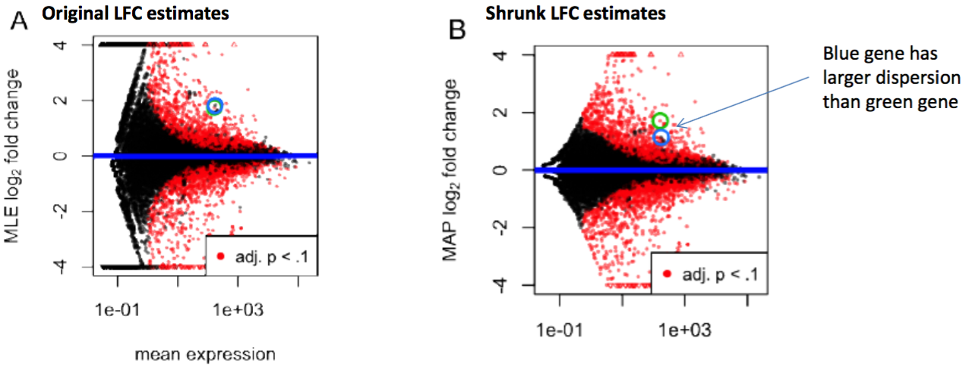
Shrinkage of log-fold change
Love et al 2014

Slide 28
edgeR vs DESeq2
EdgeR-exactTest() : more sensitive
EdgeR-QL : more conservative
DESeq2 : tight FDR control
https://mikelove.wordpress.com/2016/09/28/deseq2-or-edger/

Slide 29
Practical
Go to the website and follow the Differential Expression practical

Slide 30
Contributors: Geoffrey Fucile Walid Gharib Irene Keller Pablo Escobar Lopez Charlotte Soneson

Slide 31
Statistical modeling of RNA-Seq data
Essentially, two approaches
Non-parametric: eg voom (based on limma)
Parametric: eg edgeR and DESeq2
We will be working with the parametric approaches packaged in edgeR and DESeq2
Important assumptions:
most genes are not differentially expressed
probability of a read mapping to geneX is the same for all samples in a class

Slide 32
Statistical modeling of RNA-Seq data
Essentially, two approaches
Non-parametric: eg voom (based on limma)
Parametric: eg edgeR and DESeq2
We will be working with the parametric approaches packaged in edgeR and DESeq2
Important assumptions:
most genes are not differentially expressed
probability of a read mapping to geneX is the same for all samples in a class

Slide 33
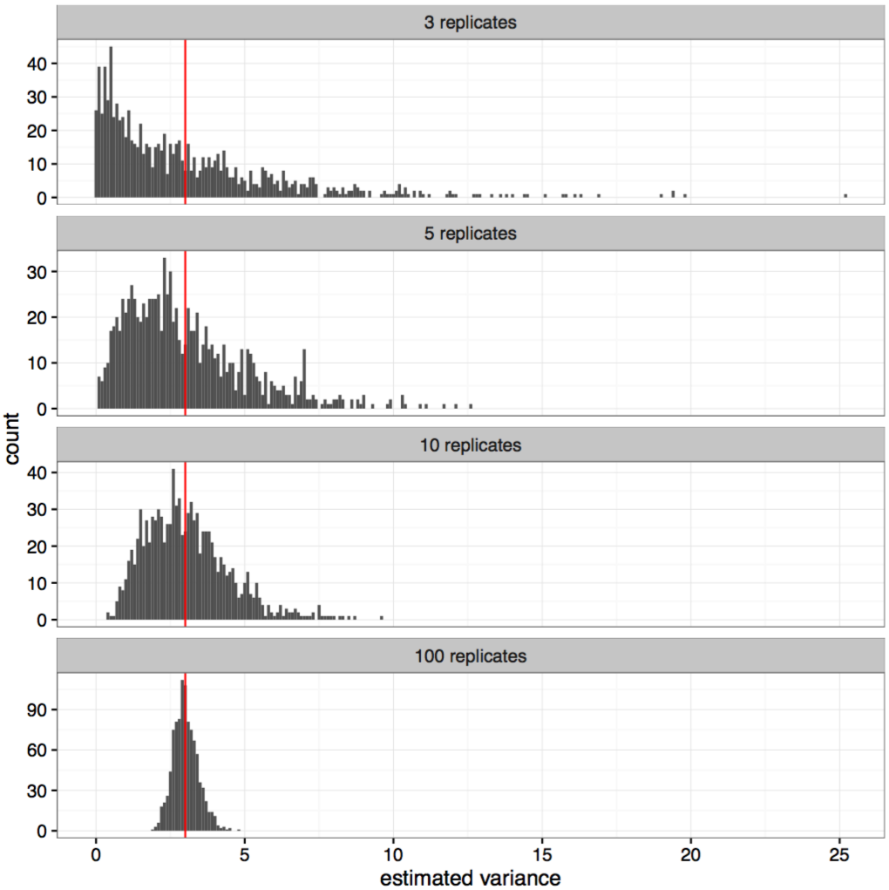
Estimating variance of a normally distributed variable
True variance = 3
What does this tell you about the ideal number of replicates for your RNA-Seq experiment?
Charlotte Soneson

Slide 34
edgeR “Robust” Mode
Dispersion estimates can be sensitive to outliers. If this is a significant aspect of your dataset, edgeR has a more robust implementation to estimate dispersions:
https://www.rdocumentation.org/packages/edgeR/versions/3.14.0/topics/estimateGLMRobustDisp

